Slide 1



Analyzing & Predicting
Loan Default Risks
A Data-Driven Approach to Financial Safety for Banks and Borrowers
Presented by Het Patel, Aamir Naveed

Slide 2


Agenda
Overview: Defining Loan Default
Data Overview: Dataset Source and Details
Exploratory Data Analysis: Visualizing Key Trends
Pattern Discovery: Association Rule Mining
Predictive Modeling: Logistic Regression vs. Trees
Customer Segmentation: Risk Zones & Pricing
Conclusion: The Financial Impact

Slide 3

What is Loan Default?
Definition
Target Variable
Loan default occurs when a borrower fails to repay a loan according to the agreed terms. It is the failure to meet the legal obligations (or conditions) of a loan.
In our dataset, this is a binary classification problem:
0 (Default): Failed to pay.
1 (Paid): Successfully repaid.

Slide 4

Why Analyze Default?
For Banks
For Customers
Minimizes "Non-Performing Assets" (NPA). Predicting default saves millions in lost capital and avoids costly legal recovery processes.
Prevents predatory lending. Helps applicants avoid taking on debt burdens they statistically cannot manage, protecting their long-term financial health.
Goal: Create a "Win-Win" ecosystem of responsible lending.

Slide 5






Dataset Overview
Source & Volume
Data Integrity
Data Types
Sourced from Kaggle Loan Dataset containing 20,000 unique loan applicants.
0 Missing Values. A clean dataset requiring no imputation, ensuring high reliability.
Mixed Data:
Nominal (Gender,Marital Status)
Ordinal (Educational Level, Grade)
Ratio (Annual Income, Loan Amt)
Interval (Credit Score)
Binary(Loan Paid Back)

Slide 6
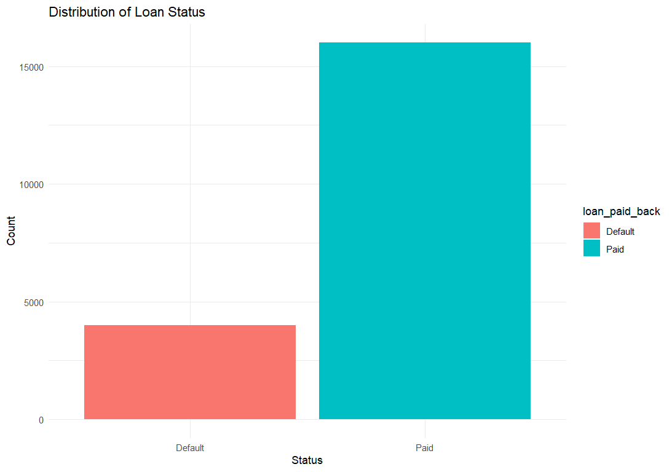
Exploratory Data Analysis
Class Imbalance: There are less number of people who have defaulted on their loans.

Slide 7
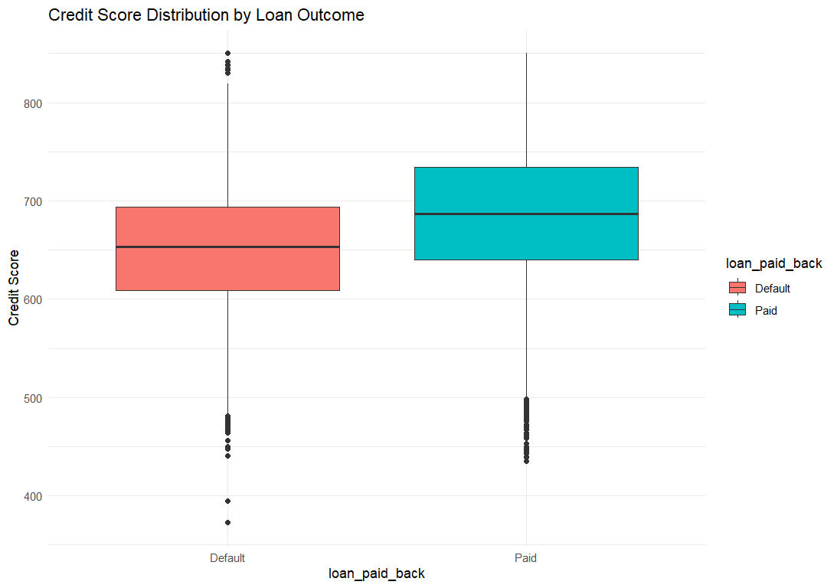
Exploratory Data Analysis
Credit Score Distribution: Defaulters have lower median credit score compared to people who have paid their loans

Slide 8
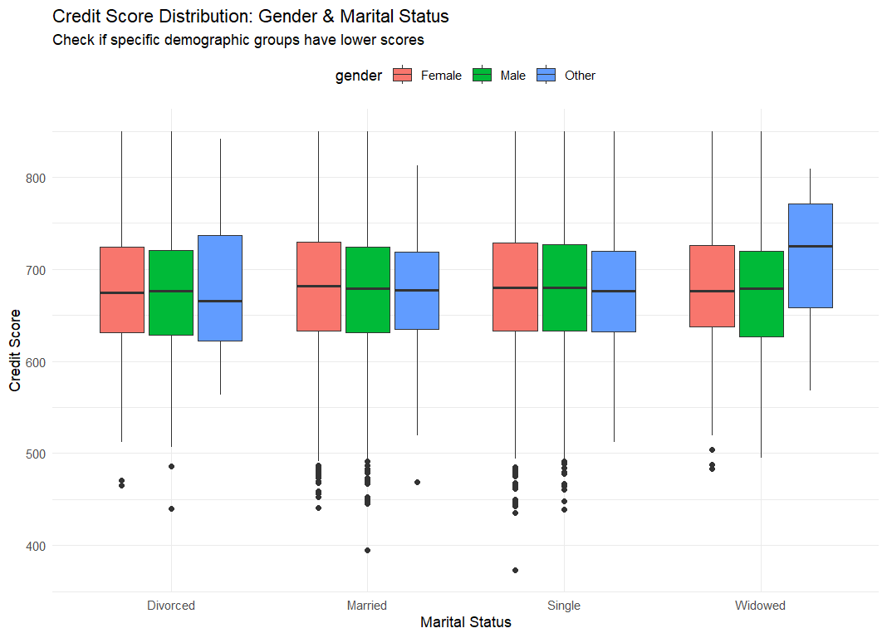
Exploratory Data Analysis
No Distinct Pattern: Gender and Marital status have no effect on a person’s credit score

Slide 9
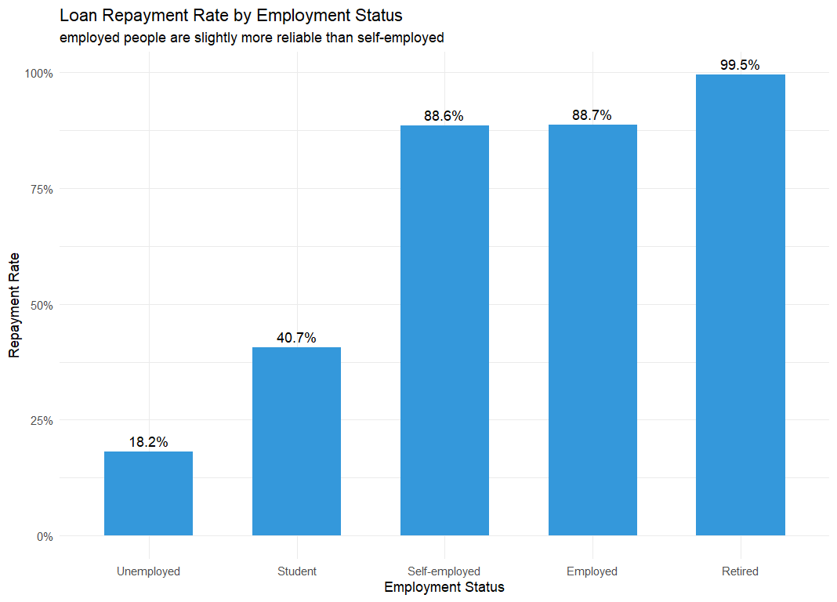
Exploratory Data Analysis
Important Factor: Unemployed people and students default more on their loans.

Slide 10
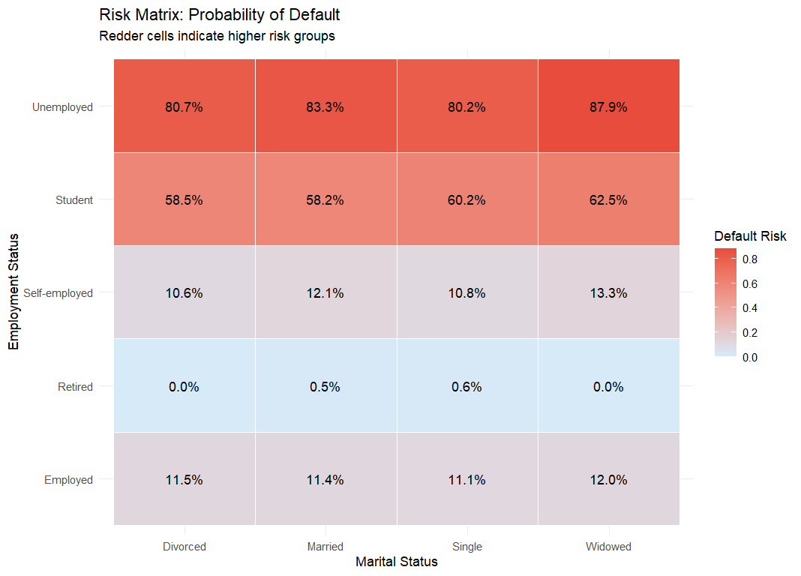
Exploratory Data Analysis

Slide 11
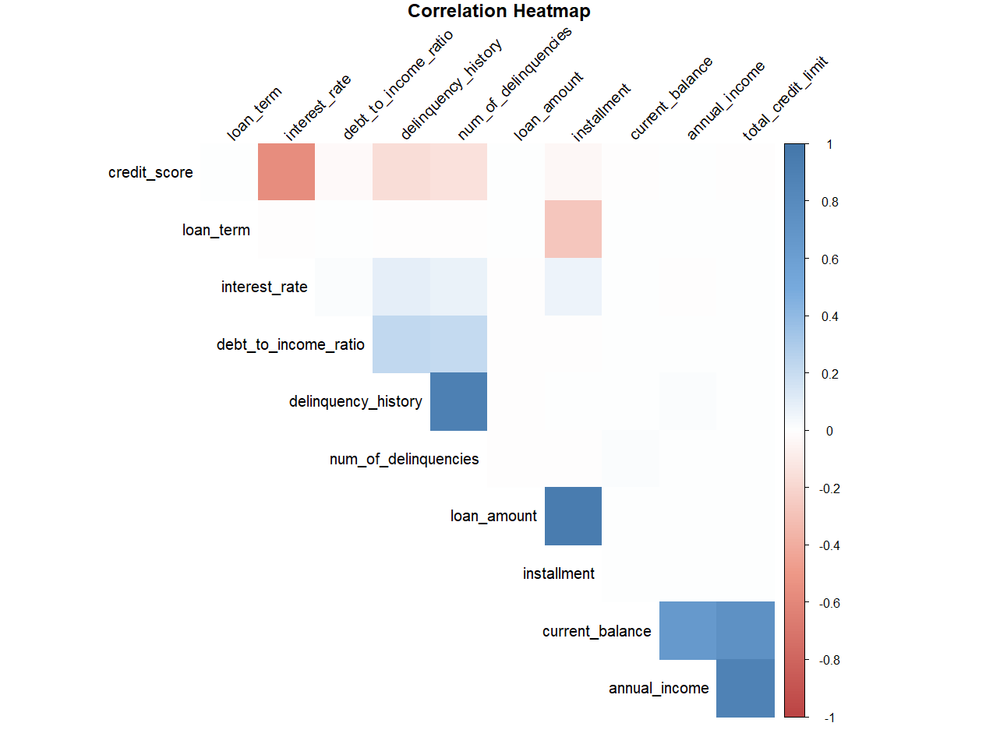
Exploratory Data Analysis

Slide 12



Association Rule Mining: The Setup
The Challenge
The Solution
Methodology
Algorithms like Apriori cannot handle raw continuous numbers (e.g., Income: $50,000).
Binning (Discretization) using Equal Frequency Binning to split data into balanced groups.
Income: Low, Medium, High
Credit: Poor, Fair, Good
DTI: Low, Med, High Risk

Slide 13
Association Rule Mining: Bin Boundaries
DTI Group
Low Risk | 0.01 - 0.12
Medium Risk | 0.12 - 0.21
High Risk | 0.21 - 0.67
Credit Group
Poor | 373 - 650
Fair | 650 - 709
High | 709 - 850
Income Group
Low | 6000 - 28096
Medium | 28096 - 47315
High | 47315 - 400000

Slide 14


Key Findings: Apriori Rules
The Default Driver
The Safety Net
{loan_paid_back = Default}
{Credit_Group = Good}
+
{DTI_Group = Low_Risk}
is strongly associated with
{DTI_Group = High_Risk}
results in {Paid} with very high confidence.
Debt-to-Income ratio is a massive early indicator of default.
Support = 10%
Confidence = 50.24%
Support = 11%
Confidence = 99.51%

Slide 15
Key Findings: ECLAT Rules
The Safety Net
The Safety Net
{loan_paid_back = Paid}
{Credit_Group = Good}
+
{DTI_Group = Low_Risk}
+
{Employment_statues = Employed}
is strongly associated with
{Employment_status = Retired}
Employment Status ratio is a massive early indicator of paid.
Support = 5.8%
Confidence = 99.48%
results in {Paid} with very high confidence.
Support = 7.2%
Confidence = 99.93%

Slide 16
Predictive Modeling
Logistic Regression
Decision Trees
The standard statistical approach. Estimates the probability of a binary outcome based on input variables.
A non-linear, rule-based approach that splits data into branches to make predictions.
Handles class imbalance better
Interpretable
Captures complex patterns
Struggles with non-linear data

Slide 17
Logistic Regression Results
Confusion Matrix |  | Reference
 |  | Default | Paid
 | Default | 303 | 478
 | Paid | 897 | 4321
Prediction
77.08%
38.8%
ACCURACY
PRECISION (DEFAULT)
The Class Imbalance Problem: Because most people pay back loans, the model became biased toward predicting "Paid," resulting in a dangerously low detection rate for actual defaulters.

Slide 18
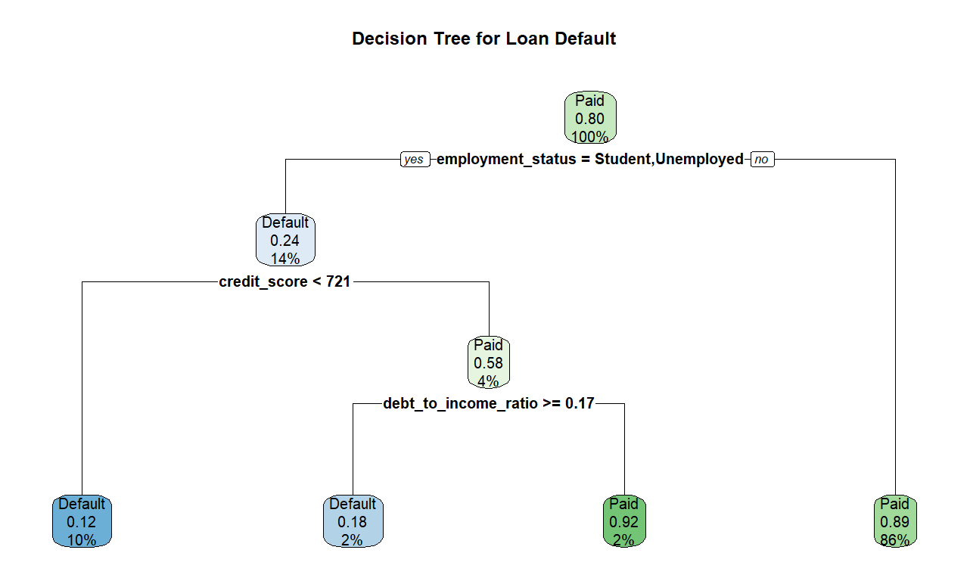
Decision Tree Superiority
Confusion Matrix |  | Reference
 |  | Default | Paid
 | Default | 642 | 98
 | Paid | 558 | 4701
Prediction
The Winner
Accuracy: 89.06%
Precision (Default): 86.76%
Impact: Correctly identified 642 defaulters, compared to Logistic Regression 303.
Why? Decision trees handled the non-linear relationships and class imbalance significantly better in this context.

Slide 19
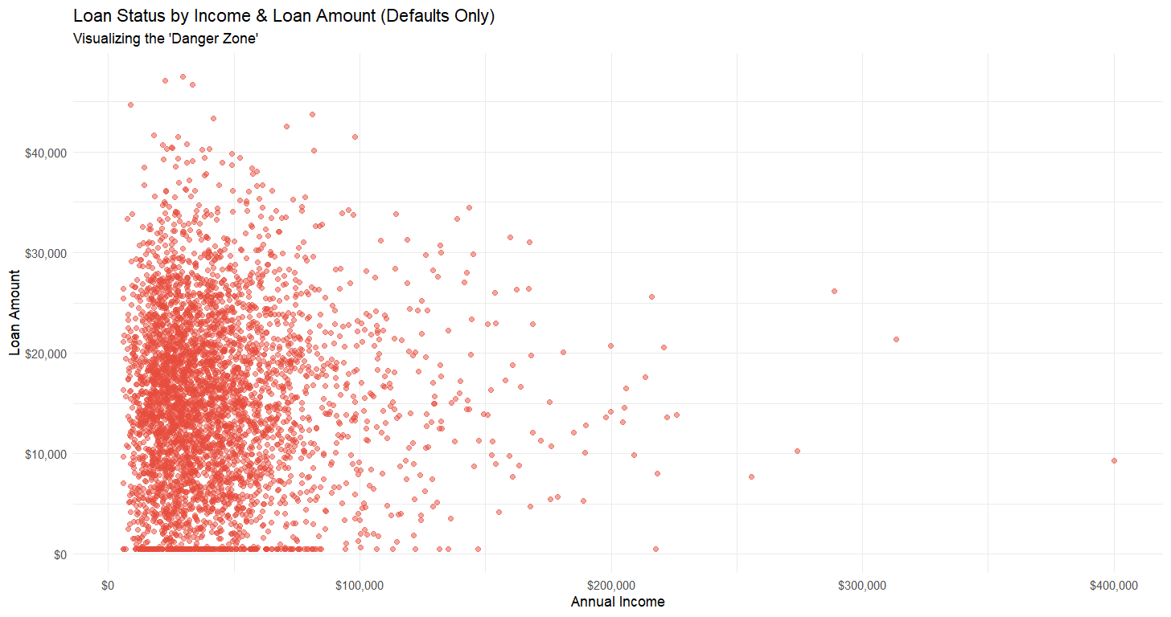
The "Danger Zone"

Slide 20
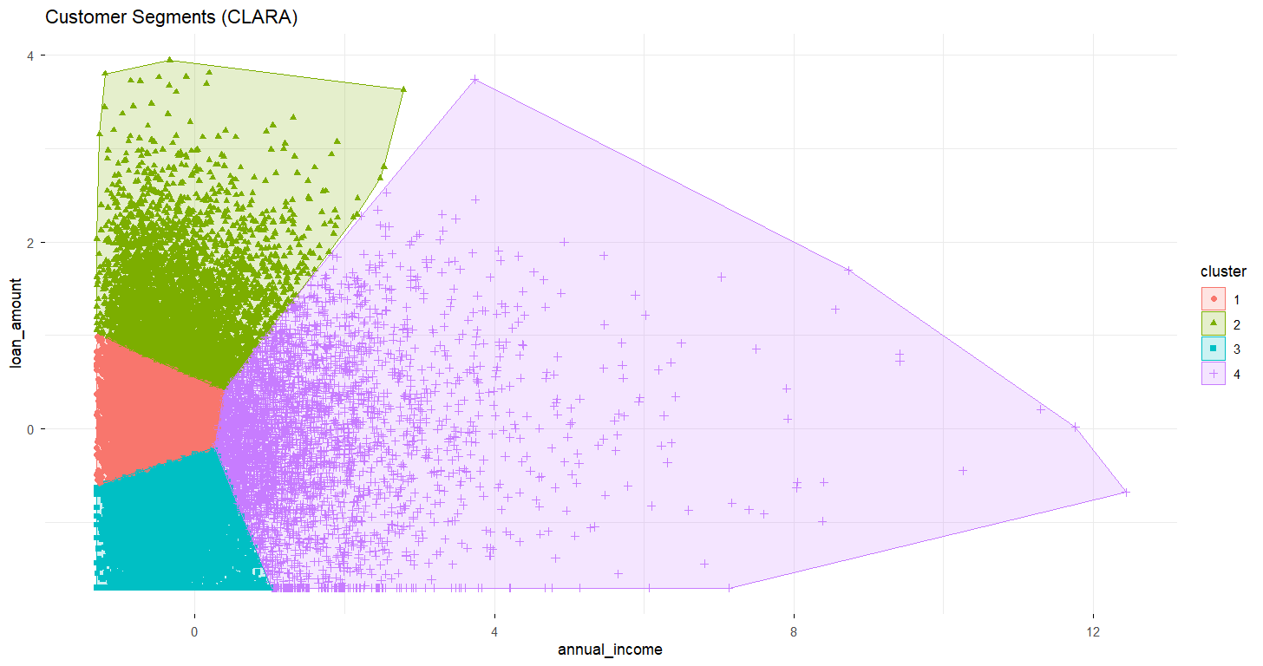
The "Danger Zone" (CLARA Clustering)
Method: Standard K-Means struggles with noise in datasets; CLARA is more robust. It repeats the sampling process multiple times and selects the set of medoids that yields the best overall clustering for the entire database

Slide 21
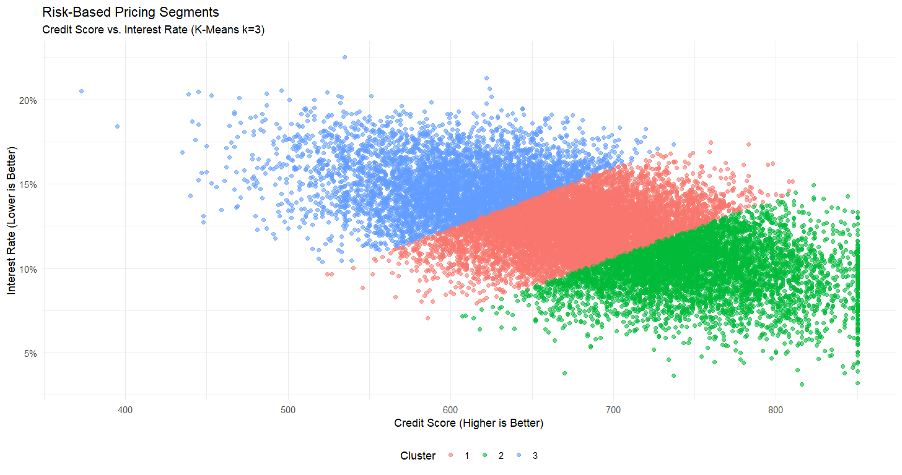
Risk-Based Pricing (K-Means)
Hypothesis Check: Do banks actually charge risky people more? We clustered Credit Scores vs. Interest Rates.
Conclusion: The bank is rationally pricing risk, but high interest rates on subprime borrowers may also be contributing to the default loop.

Slide 22


Refined Analysis: The Loop Back
Optimization Strategy
Data-Driven Thresholds
Instead of arbitrary "Equal Frequency" bins, we re-ran Association Rules using the Cluster Centers we just found.
•
New Income Breaks: $37k, $78k (derived from CLARA)
•
New Credit Breaks: 638, 715 (derived from K-Means)

Slide 23

The Power of 0.1%
Using cluster-based bins improved our rule confidence by just 0.1%.
BUSINESS IMPACT
"In high-volume finance, marginal gains in model precision translate into massive capital preservation."

Slide 24
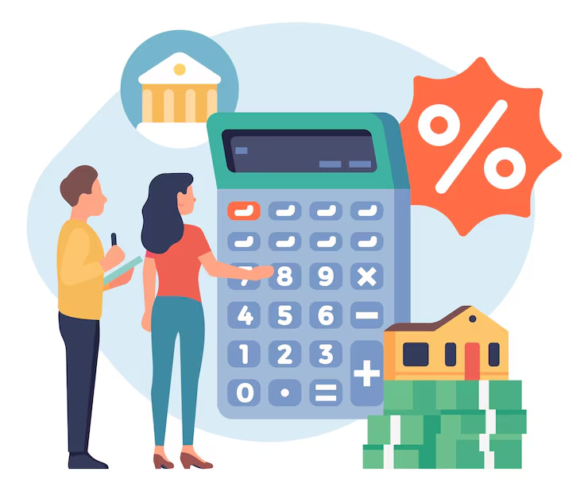
Thank You

